Slide 1
Introduction to Crypto
1
Cryptos: Chain Properties and Value
Kathryn Zhao
Denis Imaev

Slide 2
Introduction to Crypto
Scalability
In a large network, many things happen in parallel
Challenge: how to achieve one shared state quickly?
We want fast state synchronization
Parallel state changes cause forks: parallel views of global state
Fork reconciliation takes time: choosing the main chain, discarding forks etc.
Finality: transactions are “settled” forever on the chain (part of the single chosen fork)
How to solve this without sacrificing decentralization?

Slide 3
Introduction to Crypto
Scalability: Level 2
Not all individual transactions need to be propagated? Maybe they can be localized somehow….
Do not “commit” them to the chain right away: batch or conflate them first
Level 2: batch process multiple transactions and introduce the end state only to the main network.
This can be done on a localized blockchain

Slide 4
Introduction to Crypto
Level 2 example
Multiple buys and sells on the same account
The balance shrinks and grows back and forth
The final balance can be recorded as a single change
Settlement phase in the trading industry - conflate multiple transactions of the opposite sides over a period into one single asset transfer
Bitcoin Lightning works this way

Slide 5
Introduction to Crypto
Scalability: partitioning
Subnets: custom rules for network nodes, security model (Avalanche, Cosmos, Polkadot)
Shards (Ethereum, Near, Kadena): partition by various criteria to cope with transaction volume
Private chains (Avalanche custom validator rules: geography, KYC, “private” participation etc)
Recursive??

Slide 6
Introduction to Crypto
Decentralization: such a big deal?
Generic public (highly decentralized) blockchain:
Limited control over resources and costs
Everyone “competes” for the same network resources
Unknown and unpredictable costs for network usage (fees).
Generic security: by not trusting anyone, you trust everyone.
Not everyone wants that. People want “private party” rules and willing to trust well-known and agreed upon players.

Slide 7
Introduction to Crypto
Centralization (to some degree)
Common rules of engagement and participation: easier to maintain control over resources and choose a custom security model.
Centralization -> control over resources, custom security (level of trust)
Other factors: geographic proximity. Some locations are toxic.

Slide 8
Introduction to Crypto
Centralization (to some degree)
Subnets: custom rules for network nodes, security model (Avalanche, Cosmos, Polkadot)
Shards (Ethereum, Near): partition by various criteria to cope with transaction volume
Private chains (Avalanche etc.)
Super nodes: well known entities that everyone trusts (Stellar with Franklin Templeton, Hedera with Industrial giants)

Slide 9
Introduction to Crypto
Security
Bitcoin has never been broken or hacked
Forked… yes… but never hacked!
Going back to the origins: lets build on top of bitcoin
Bitcoin L2, Ordinals for NFT, Runes for fungibles etc.

Slide 10
Introduction to Crypto
Many Chains, one Security!
Merge mining: use the same “work” to mine several chains
“Anchor” the 2nd chain by embedding its blocks in the main chain
Piggyback on the existing security model

Slide 11
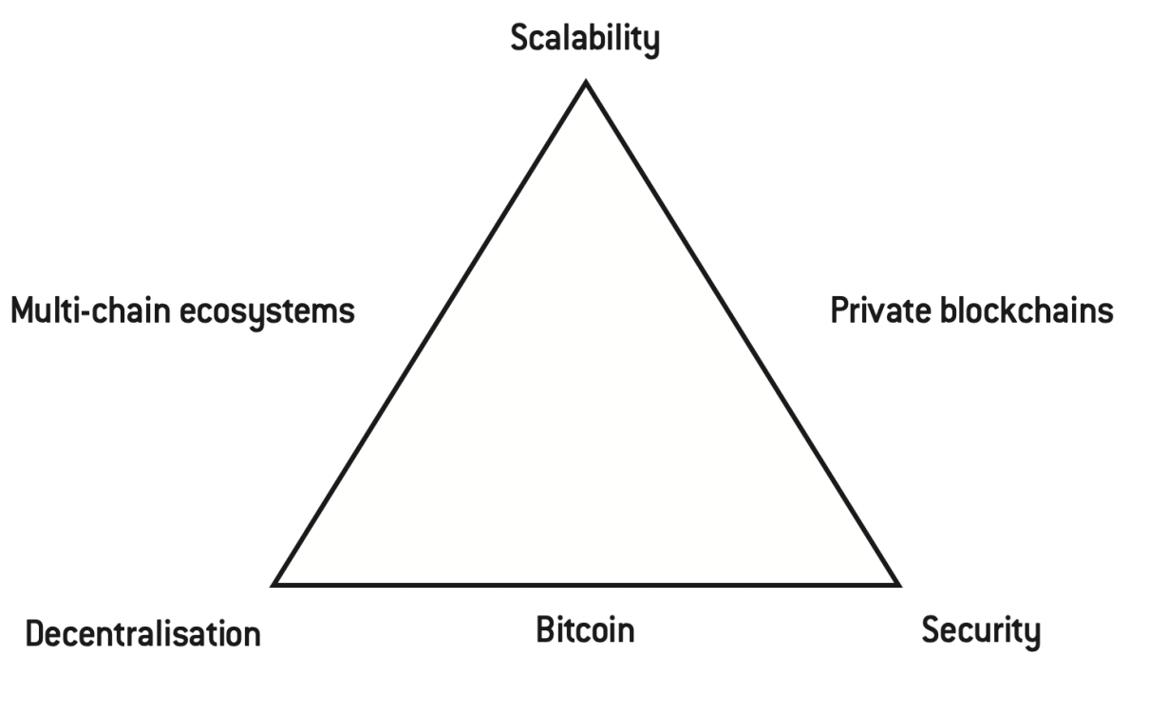
Introduction to Crypto
Decentralization?
Security?
Scalability?
Debate is on-going….

Slide 12
Introduction to Crypto
Why so many blockchains??
Any innovation goes through this stage
Projects in the thousands…
Some are nothing more than a white paper!
Fragmentation, multiple teams and enthusiasts trying new things
We are not sure yet what works and how well
Often acceptance/popularity wins over quality

Slide 13
Introduction to Crypto
Digital assets (blockchain) value
Distributed incorruptible state
Governed by open code, not arbitrary laws made by 3rd parties outside of public control.
2. Distributed computer
on top of that shared, distributed, incorruptible state.
3. Specific tasks (applications) that this computer runs.

Slide 14
Introduction to Crypto
Digital assets (blockchain) value
Implications in the age of AI: AI needs massive computational resources that are hard to maintain centrally.
Blockchains solve these problems!

Slide 15
Introduction to Crypto
Digital assets’ value factors
Specific purpose it serves
A widely adopted, fast and secure payment system
A utility coin is used as payment for some service.
Smart contract (an app on a chain) performs some service. You pay for using it by sending the token to that Smart contract.
Example: an AI agent running a task, a trading app, distributed storage, a game etc.

Slide 16
Introduction to Crypto
Digital assets’ value factors
Consensus
Is it hard to break? Any vulnerabilities?
Is it expensive to run?
How decentralized is it?
Example: projects with solid technical foundations, rich smart contract programming paradigm etc. but only few super potentially under control of some centralized authority

Slide 17
Introduction to Crypto
Adoption rate, usage
A lot of coins are nothing more than just a white paper
How many active addresses? How geographically widespread are they?
Strength of the ecosystem: support by exchanges, wallets, browsers
Interoperability: ability to interact with other networks
Existence and success of Level 2 chains
Usage in a large scale, commercial or high-profile project.
A “killer app”: something that is lacking at the moment

Slide 18
Introduction to Crypto
Technical strength
Speed, cost
History of downtime, attacks, stolen funds, etc.
Strength and size of the engineering team actively working on the project.
BTC core dev team: several hundred, maybe a thousand. Should we be worried?
ETH core dev team: several thousand of developers actively working.
Quality of implementation. Are there any independent reviews?
Quality and maturity of the smart contract virtual machine, if applicable
Academic research

Slide 19
Introduction to Crypto
Governance
How easy is it to make a change to code (everything is code!)
How does the change process work and how does the community come to agreements?
“Governance” attack:
1. borrow or buy the token
2. obtain majority of tokens, or just enough to have a vote
3. vote and change the rules to your advantage
4. sell/give back the token
This all can happen in a split second.

Slide 20
Introduction to Crypto
“Off-chain” factors
Supporters
Funding and treasury
Profit generated
Media coverage
Institutional investor interest

Slide 21
Introduction to Crypto
Examples
Stablecoins: traditional money that lives on blockchain
USDT, USDC, DAI, …
Smart contracts define their issuance and lifecycle, not governments
Bridge from TradFi to DeFi: same money but technically superior and safe
Privacy coins (Bitcoin: anonymous, but fully transparent)
Monero, ZCash
Mixers (TornadoCash)
Good or bad?

Slide 22
Introduction to Crypto
Examples
NFT: a “digital asset”
Really just a signed piece of data
Resource sharing: a promising idea
Filecoin: not so niche anymore!
Akash: buy/sell computing power.
AI drives the need!
Stellar, DASH, XRP: remittances, cross-border payments
Proven use case where fiat money is failing

Slide 23
Introduction to Crypto
Examples
Chilliz: platform for a fanbase
Betting, gaming: application-specific assets
Memecoins
DOGE, SHIB: dog times are in the past!
Its cats time now: POPCAT, MICHI…
Note how use cases drag the chain popularity with them. That’s adoption rate! That’s helps the underlying chain.

Slide 24
Introduction to Crypto
“Oracle Problem”
Blockchain needs “real world” data: Market Data, Weather, Names, sensor data…
How to access real world data from the Blockchain?
Blockchain security and other advantages are in its deterministic and isolated nature
Decentralization → over-validation, shared state
Immutability → security
Data from the “imperfect” outside world poses a risk.
“Bad”, corrupt, inaccurate data cannot be fixed/corrected!

Slide 25
Introduction to Crypto
“Oracle Problem” (cont.)
All nodes must have a coherent, unified view of the same data, so Contracts execution have the same results
Make blockchain itself access the data? Not technologically sound.
- subjectivity: multiple unsynchronized sources
- vulnerability: increases the surface of potential attack
- complexity: overloads the network with additional tasks
Oracles: bring off-chain data onto network

Slide 26
Introduction to Crypto
Oracles: blockchains
How do we trust Oracles to provide correct data? Make them a chain itself!
Same security framework and incentive concept at work! Multiple nodes collect off-chain data
Multiple sources are processed into a unified value via filtering, averaging etc.
Data provider nodes lock up funds
Cheater’s locked funds are lost
“Slashing” is a popular punishment concept!

